Slide 1
Project Quality

Slide 2
Quality
Quality : Meeting Expectation & Requirements. (Degree, confermance, Grade)
Software Quality [What it must be done (Requirements)]
User view
Developer view (Manufacture)
Transactional view
Quality Software [How it must e done (Requirements + Standards)]
User requirements
User satisfaction
Global Standards
Fitness for the purpose

Slide 3
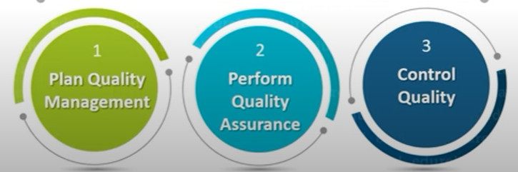
Three Core Process

Slide 4
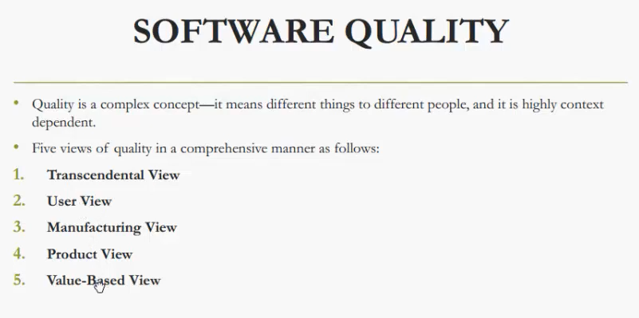

Slide 5
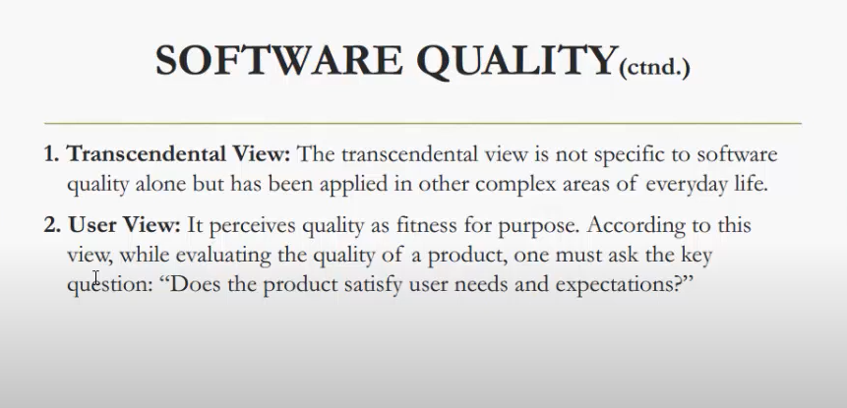

Slide 6
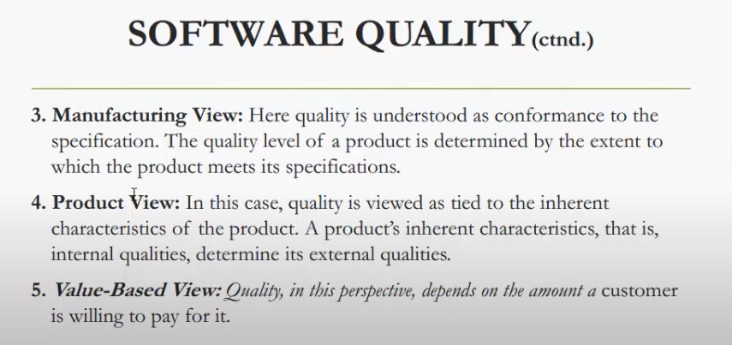

Slide 7
ISO Quality Factors
Functionality (Core Capabilities)
Reliability (Fault Free)
Usability (Understandability, Learnability, Operatability)
Efficiency (Time Vs Resources)
Maintainability (Analyzability, Changeability, Stability, Testability)
Portability (Adaptability, Install-ability, Replicability)

Slide 8
Maccalls Quality Factors
Correctness
Reliability
Efficiency
Integrity (Un-wanted treats)
Usability
Maintainability
Flexibility (Scalability)
Portability (Transferring system from one to another environment)
Reusability
Interoperatability

Slide 9
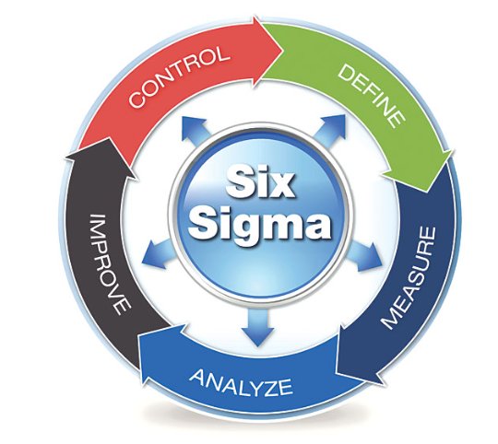
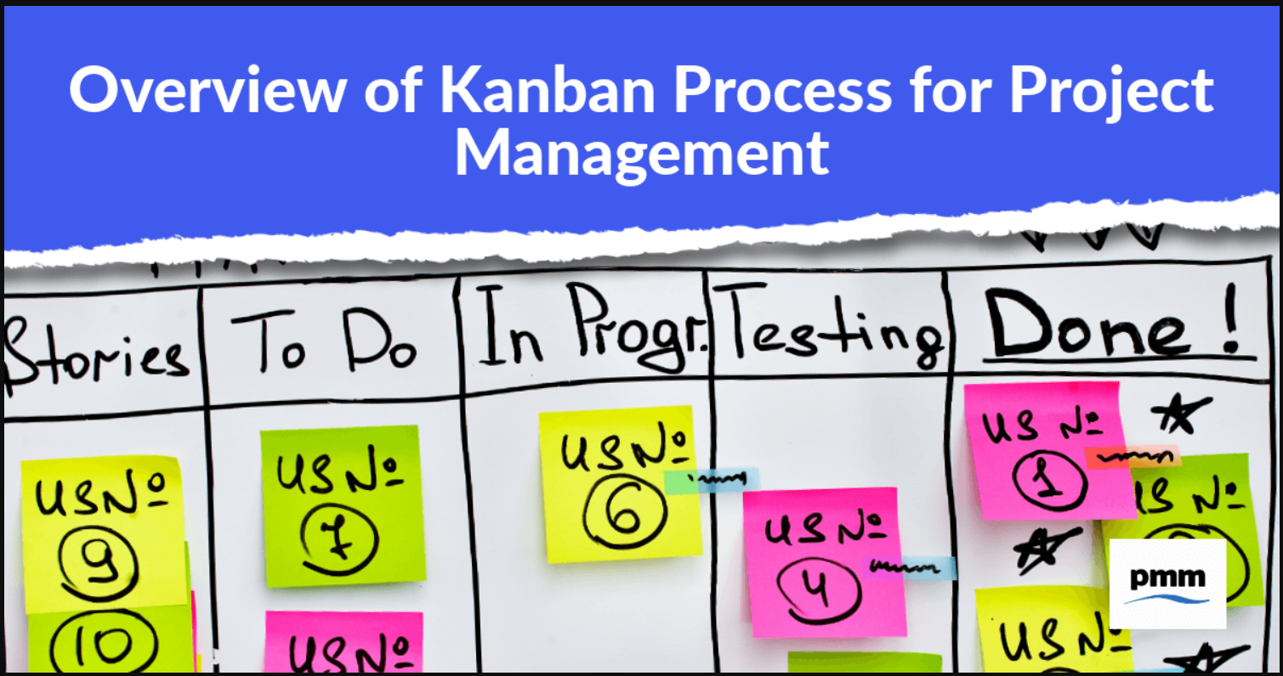
Other Standards
LEAN
Six Sigma
Kanban

Slide 10
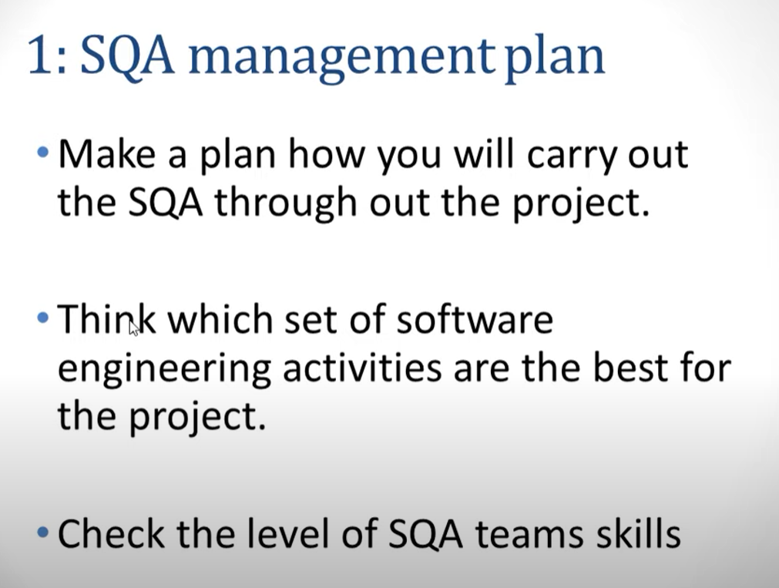
Top 5 SQA Activities

Slide 11
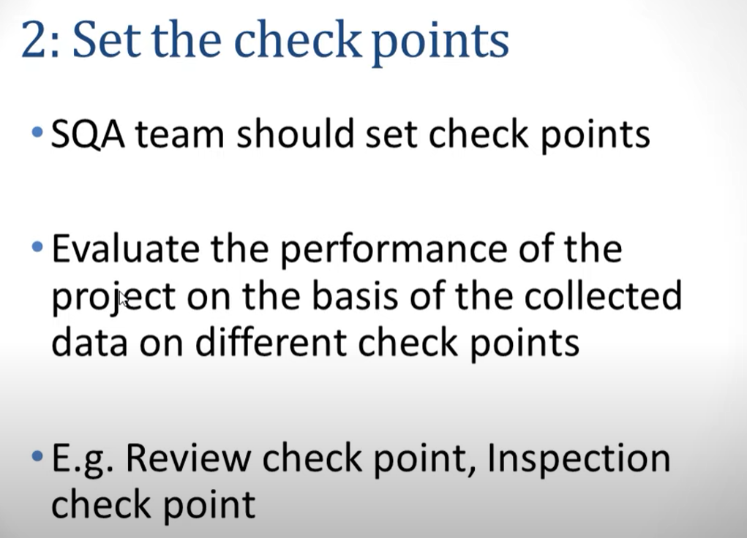

Slide 12
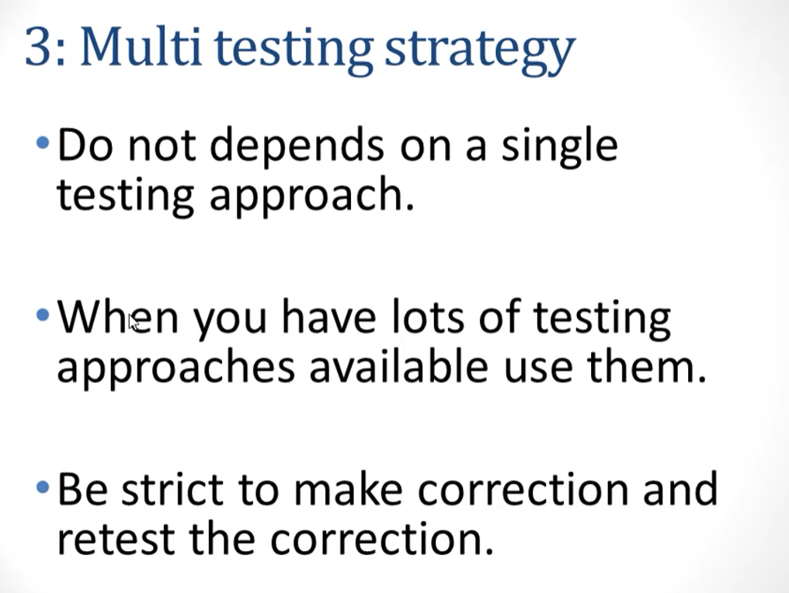

Slide 13
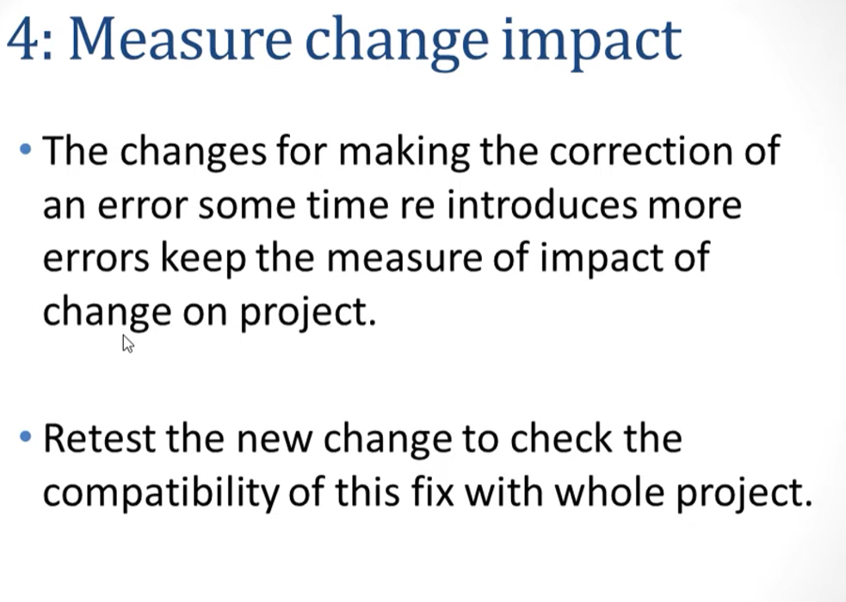

Slide 14
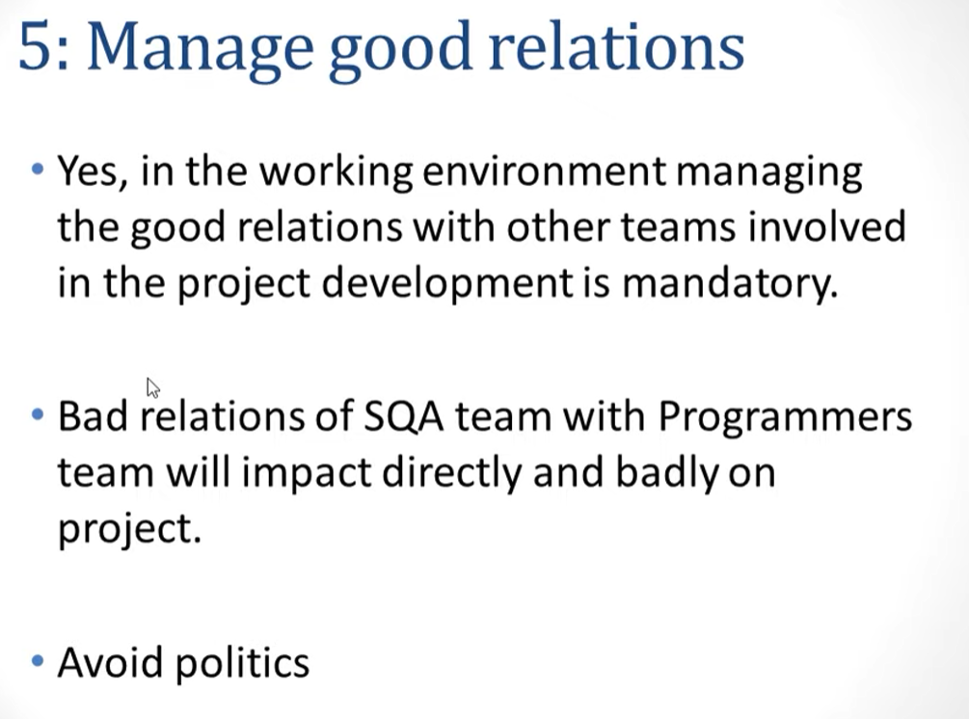

Slide 15
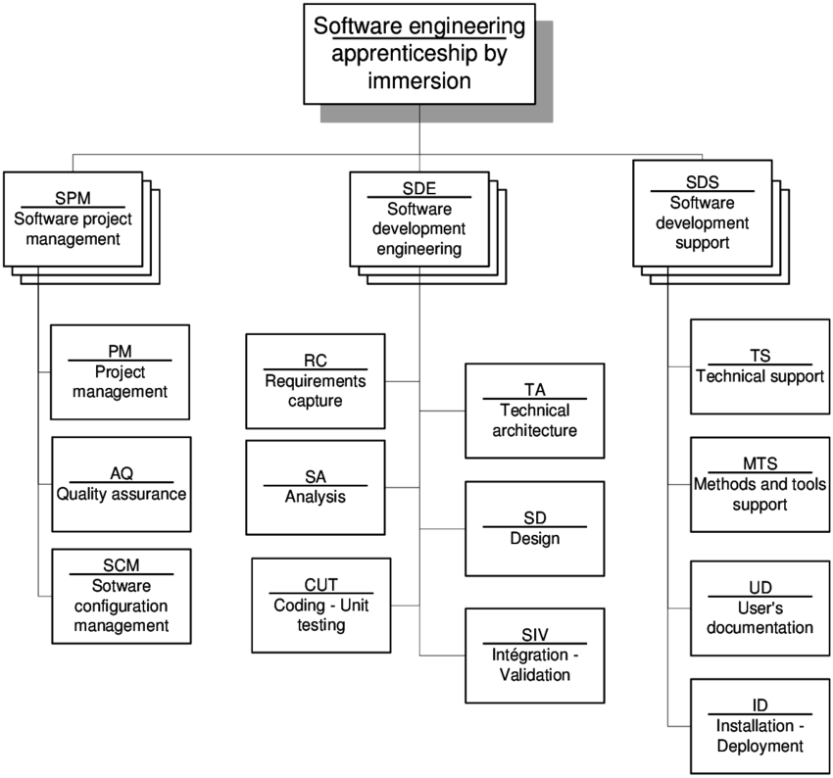
Activity Break Down ISO/IEC

Slide 16
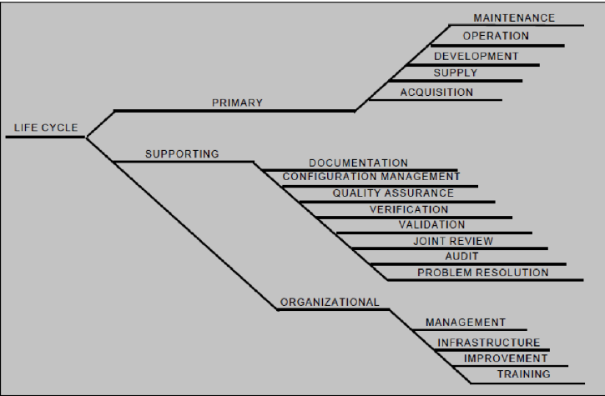
Life Cycle ISO/IEC

Slide 17
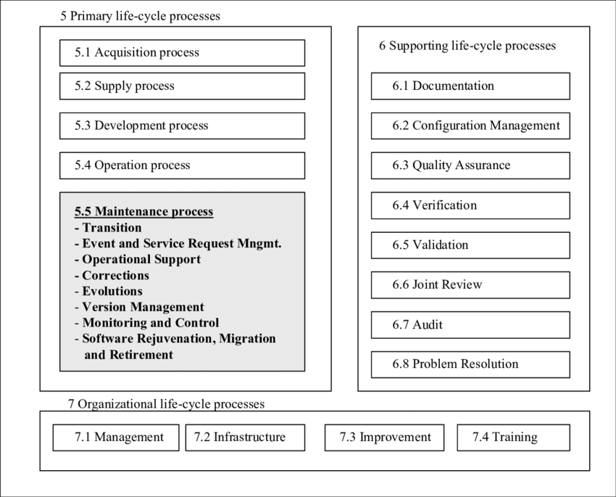
Proposed Update

Slide 18
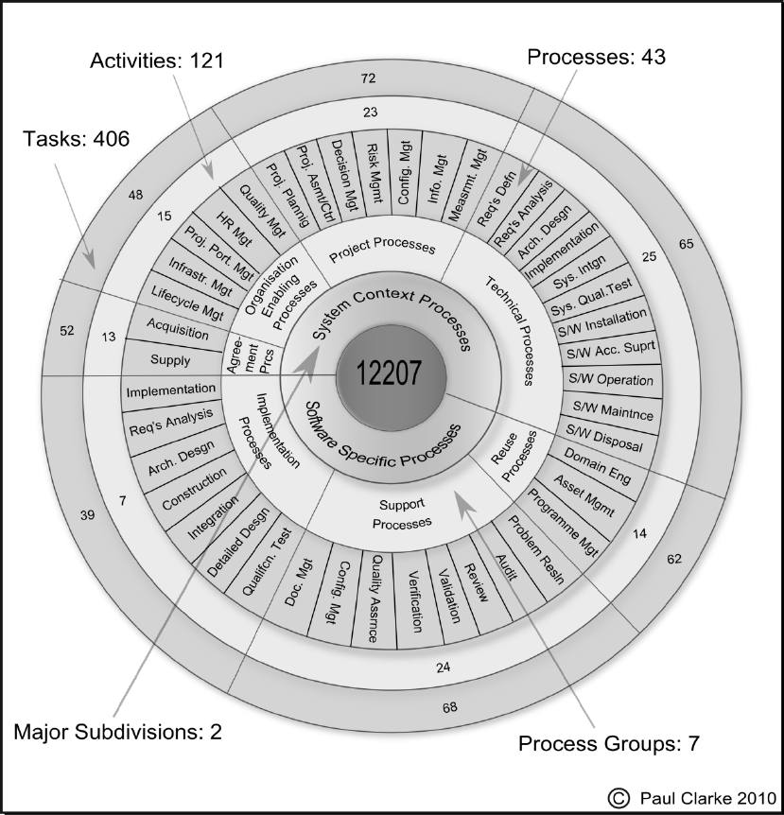
Project Management Topology

